Slide 1
Chapter 1
The 8051 Microcontrollers

Slide 2
Outlines
Compare microprocessors & microcontrollers
Advantages of microcontrollers
Embedded systems
Choose a microcontroller
Speed, packaging, memory & cost per unit
Various members of 8051 family
Various manufacturers of 8051

Slide 3
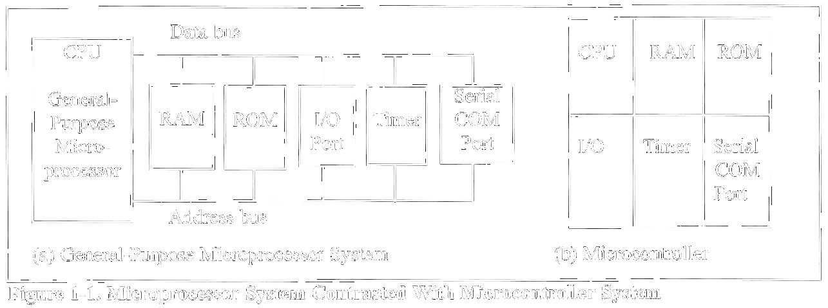
Microcontroller vs. Microprocessors

Slide 4
Embedded Computing Systems
Use a microprocessor or microcontroller to do one task only
  Printer
PC used for any number of applications
  Word processor, print-server, bank teller terminal, video game player, network server, internet terminal
PC contains or is connected to various embedded products
  Keyboard, printer, modem, disk controller, sound card, CD-ROM driver, mouse
X86 PC embedded applications

Slide 5
Embedded Products Using Microcontrollers
Home
  Appliances, intercom, telephones, security systems, garage door openers, answering machines, fax machines, home computers, TVs, cable TV tuner, VCR, camcorder, remote controls, video games, cellular phones, musical instruments, sewing machines, lighting control, paging, camera, pinball machines, toys, exercise equipment

Slide 6
Embedded Products Using Microcontrollers
Office
  Telephones, computers, security systems, fax machines, microwave, copier, laser printer, color printer, paging

Slide 7
Embedded Products Using Microcontrollers
Auto
  Trip computer, engine control, air bag, ABS, instrumentation, security system, transmission control, entertainment, climate control, cellular phone, keyless entry

Slide 8
Choosing A Microcontroller
Computing needs
  Speed, packaging, power consumption, RAM, ROM, I/O pins, timers, upgrade to high performance or low-power versions, cost
Software development tools
  Assembler, debugger, C compiler, emulator, technical support
Availability & source

Slide 9
Companies Producing 8051
Table 1-2:Some Companies Producing a Member of the 8051 Family
Company | Web Site
Intel | www.intel.com/design/mcs51
Atmel | www.atmel.com
Philips/Signetics | www.semiconductors.philips.com
Siemens | www.sci.siemens.com
Dallas Semiconductor | www.dalsemi.com

Slide 10
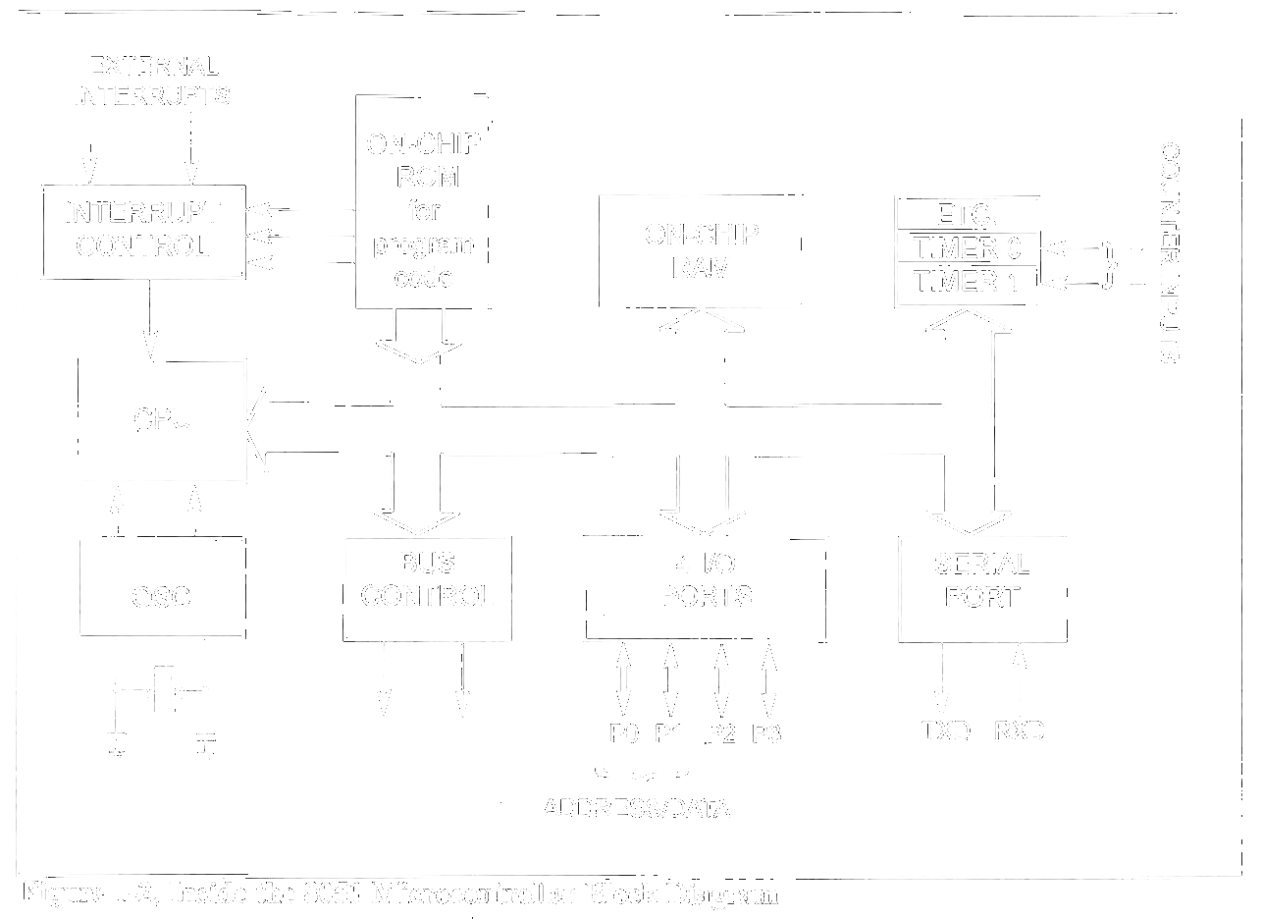
Inside 8051 Microcontroller
Introduced by Intel in 1981

Slide 11
8051 Family
Table 1-4:Comparison of 8051 Family Members
Feature | 8051 | 8052 | 8031
ROM (on chip program space in bytes) | 4K | 8k | 0k
RAM (bytes) | 128 | 256 | 128
Timers | 2 | 3 | 2
I/O pins | 32 | 32 | 32
Serial port | 1 | 1 | 1
Interrupt sources | 6 | 8 | 6

Slide 12
Various 8051 Microcontrollers
8751 microcontroller
  UV-EPROM
AT89C51 from Atmel Corporation
  Flash (erase before write)
DS5000 from Dallas Semiconductor
  NV-RAM (changed one byte at a time), RTC (real-time clock)
OTP (one-time-programmable) version of 8051
8051 family from Philips
  AD, DA, extended I/O, OTP and flash

